Slide 1
Satellite-Based Validation of Contrail Prediction Models for Sustainable Aviation Final Team ID: P174 Panel No.: 15
S.No | Reg.No | Name of the Student | Branch & Section
1 | BL.EN.U4AIE20007 | Baddireddi Sree Chandana | AIE - D
2 | BL.EN.U4AIE20046 | P Nandieswar Reddy | AIE - D
3 | BL.EN.U4AIE20054 | Rithvika Alapati | AIE - D
4 | BL.EN.U4AIE20056 | Sai Aswath S | AIE - D
Project Guide: Ms. Radha D
Computer Science Dept.

Slide 2
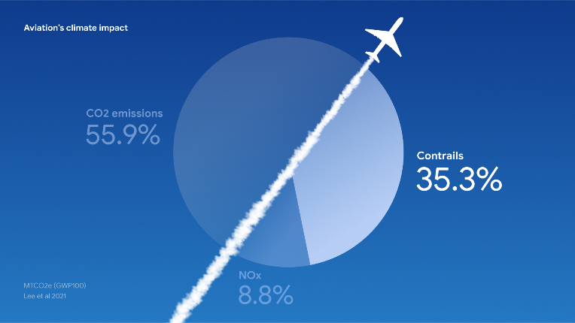
Introduction
Contrails, or condensation trails, are clouds formed by the condensation of water vapor around particles emitted by aircraft engines.
These line-shaped clouds contribute to global warming by trapping heat and reflecting sunlight.
Studies indicate that contrails account for about 35% of aviation's global warming impact.

Slide 3
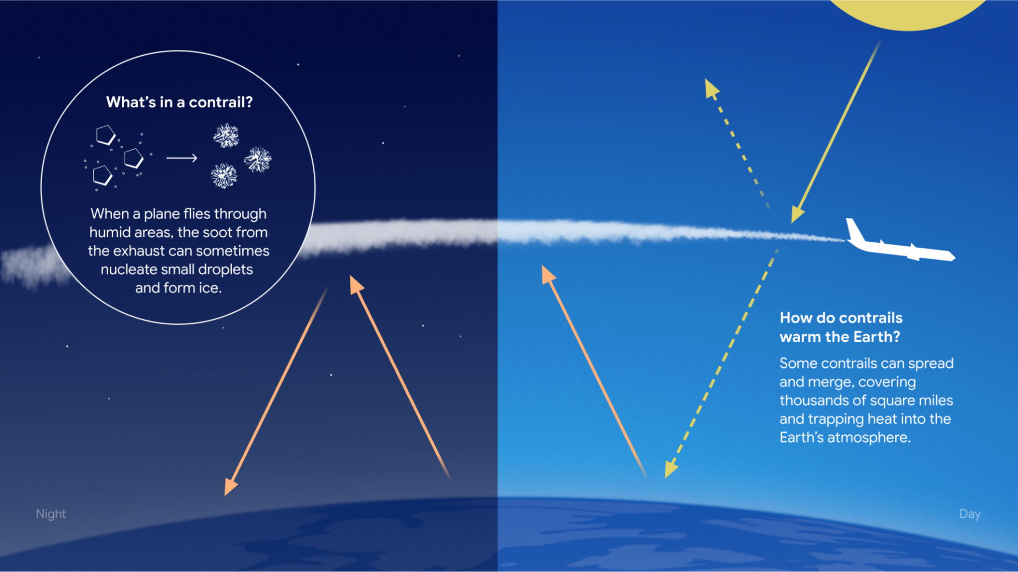

Slide 4
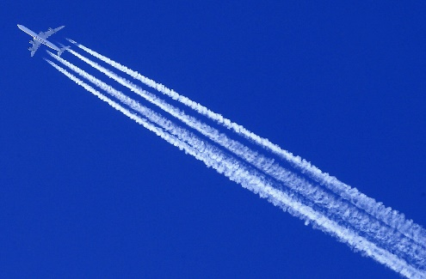
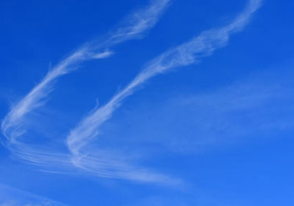
Problem Definition
Predicting the occurrence and behavior of contrails in satellite imagery poses a challenging problem.
Contrails are identified as a key contributor to climate change due to their ability to trap heat in the atmosphere, exacerbating the environmental impact of air travel.
Predictive models for contrail are trained using satellite imagery to validate contrail prediction models in real-world conditions.
The aim is to develop an effective deep learning model capable of accurately predicting contrail patterns essential for addressing the environmental impact of aviation emissions.

Slide 5
Literature Survey
S.No. | Authors name(s) | Full title of the paper with year | Inference from the paper | Open Problem (For proposed work)
1 | Joe Yue-Hei Ng, Kevin McCloskey, Jian Cui, Vincent R. Meijer, Erica Brand, Aaron Sarna, Nita Goyal, Christopher Van Arsdale, Scott Geraedts | OpenContrails: Benchmarking Contrail Detection on GOES-16 ABI . 2023 | This research on contrail detection underscores the importance of satellite data and convolutional neural network (CNN) models in combating aviation-induced climate change. By utilizing GOES-16 Advanced Baseline Imager (ABI), researchers have developed CNN-based contrail detection models. Also by integrating temporal context into these models through techniques like spatio-temporal encoders, hold promise for improving our understanding of contrail dynamics. | Exploring self-supervised and semi-supervised machine learning techniques to enhance contrail detection model performance. Extending research to include other geostationary satellites like Himawari-8 and Meteosat-11 will broaden coverage, particularly over Europe and the Asia-Pacific region.
2 | Rémi Chevallier, Marc Shapiro, Zebediah Engberg, Manuel Soler and Daniel Delahaye | Linear Contrails Detection, Tracking and Matching with Aircraft Using Geostationary Satellite and Air Traffic Data 2023 | The study presents a novel approach to monitor contrails and identify their associated aircraft, integrating air traffic data, weather data, and geostationary satellite images. Unlike traditional methods, it jointly solves tracking and flight identification issues, improving reliability. This facilitates merging with other observation methods, aiding contrail evolution studies. | Future work includes refining global contrail detection for consistency, potentially integrating satellite-based ADSB data. Extending contrail tracking beyond linear shape retention is valuable, with our method serving as a tool for initiating such tracking.

Slide 6
Literature Survey
S.No. | Authors name(s) | Full title of the paper with year | Inference from the paper | Open Problem (For proposed work)
3 | Nasir Siddiqui, Sylke Boyd | Atmospheric contrail detection with a deep learning algorithm.2020 | A CNN trained on TSI images from the ARM facility achieved accuracies of 97.5% (training) and 98.5% (validation) in identifying aircraft contrails. This allows for automated detection of contrails in TSI imagery, aiding research on their role in climate change. | Expanding the application of the trained convolutional neural network (CNN) to analyze images from different months could reveal insights into the seasonal variability of contrail occurrences and its correlation with air traffic trends temperature and humidity.
4 | Zhenkuan Wang | Combining UperNet and ConvNext for contrails identification to reduce global warming. 2023 | This study introduces an innovative approach to detect aircraft contrails in global satellite images using semantic segmentation. By preprocessing NOAA GOES-16 satellite images and incorporating the UPerNet architecture with ConvNeXt configurations, the model achieves exceptional performance. The method addresses class imbalance and employs the AdamW optimizer for fine-tuning. Overall, the approach shows promise for enhanced contrail recognition in satellite imagery. | The future scope of this research could be further optimization, integration of multi-modal data, real-time monitoring systems, climate impact assessment, and operational deployment can enhance contrail detection accuracy and promote sustainable aviation practices. These efforts aim to mitigate aviation's environmental footprint and support informed decision-making for environmental stewardship.

Slide 7
Literature Survey
S.No. | Authors name(s) | Full title of the paper with year | Inference from the paper | Open Problem (For proposed work)
5 | Jay P. Hoffman, Timothy F. Rahmes, Anthony J. Wimmers and Wayne F Feltz | The Application of a Convolutional Neural Network for the Detection of Contrails in Satellite Imagery .2023 | Researchers developed a Convolutional Neural Network to accurately detect contrails in satellite imagery, achieving notable results: 0.51 probability of detection, 0.46 false alarm ratio, and an F1 score of 0.52. The Area Under the Curve (AUC-PR) was 73.9, indicating superior performance. This highlights the potential of CNNs for widespread contrail monitoring and understanding their climate impact. | Future research aims to incorporate atmospheric data, such as ice saturation levels at altitude, to enhance contrail detection forecasts. By integrating this information with flight path maps and air traffic patterns, researchers can improve the accuracy of contrail detection in regions conducive to contrail formation.
6 | Akshat Bhandar, Sriya Rallabandi, Sanchit Singhal, Aditya Kasliwal, Pratinav Seth | Performance evaluation of deep segmentation models for Contrails detection, 2023 | The paper developed deep segmentation models for contrail detection in Landsat-8 imagery, with UNet using Xception 71 as the best performer, reaching an IoU of 0.4395. Despite challenges,, the model accurately segmented contrails. | Future research aims to enhance contrail detection in Landsat-8 imagery through temperature-based color preprocessing, uncertainty estimation, and advanced model techniques such as attention-based models and discriminator networks, to improve accuracy and generalization.

Slide 8
Literature Survey
S.No. | Authors name(s) | Full title of the paper with year | Inference from the paper | Open Problem (For proposed work)
7 | Yejun Le, Eun-Kyeong Kim, jaejun yoo | Towards Robust Contrail Detection by Mitigating Label Bias via a Probabilistic Deep Learning Model: A Preliminary Study.2023 | Deep learning (DL) techniques have advanced to address this need but face challenges like class imbalance and labeling difficulties. they proposed a probabilistic DL approach using P-UNet to mitigate label bias in contrail detection. Evaluating model outputs on OpenContrails and MIT-Contrails datasets, our approach shows robustness against potential label biases. | Further research could explore techniques to enhance precision while maintaining high recall, such as incorporating additional contextual information or refining labeling methodologies.
8 | Junzi Sun and Esther Roosenbrand | Flight Contrail Segmentation via Augmented Transfer Learning with Novel SR Loss Function in Hough Space, 2023 | This paper addresses the environmental impact of flight contrails on climate change, highlighting challenges in their accurate detection using conventional techniques due to limited labeled datasets and varied image conditions. To overcome these obstacles, the authors propose a novel approach based on few-shot transfer learning, utilizing pre-trained segmentation models | Future research could focus on expanding the dataset, refining the model, and exploring real-time monitoring capabilities for practical applications in climate research and aviation industries

Slide 9
Literature Survey
S.No. | Authors name(s) | Full title of the paper with year | Inference from the paper | Open Problem (For proposed work)
9 | Ardan Hüseyin Eşlik, Emre Akarslan, Fatih Onur Hocaoğlu | Creating Cloud Segmentation Data Set Using Sky Images of Afyonkarahisar Region.2024 | A cloud segmentation dataset comprising 825 sky images and corresponding masks was generated using data from Afyon Kocatepe University. transformed them into binary format for compatibility with machine learning and deep learning techniques. The dataset facilitates improved cloud location and shape prediction. | ----
10 | Caleb Akhtar Martínez and Jerome P. Jarrett | Comparing Two Contrail Models Under Certain and Uncertain Inputs, 2024 | In this study, two existing models of different fidelities, CoCiP and APCEMM, are compared under certain and uncertain inputs to understand their capabilities and sensitivity at different timescales. The comparison reveals similarities in the response to changing temperature and relative humidity but discrepancies in the evolution of contrail properties over time. | Future research should focus on acquiring more validation data to compare existing and future models accurately. Additionally, investigating the sensitivity of models to parameter changes under fixed meteorological conditions can further enhance model reliability.

Slide 10
Justification for the Proposed Problem
Contrails contribute to global warming by trapping heat in the atmosphere, exacerbating climate change.
Addressing this issue is crucial for mitigating the environmental impact of aviation, which is a significant contributor to greenhouse gas emissions.
Leveraging satellite imagery provides a practical and scalable approach to validate contrail prediction models.
Validated models empower airlines to implement effective contrail avoidance strategies, reducing their environmental footprint.
Aligning with global efforts to combat climate change, this research contributes to the broader goal of achieving sustainability in the aviation sector.

Slide 11
Software/Tools Requirements
Operating System: Windows
Programming Language: Python
IDE: Jupyter Notebook
Data Visualization Tools: Matplotlib, Seaborn
Machine Learning Libraries: Scikit-learn, TensorFlow, PyTorch
Statistical Analysis Tools: Pandas, NumPy, or SciPy

Slide 12
Data Set
Dataset link : https://www.kaggle.com/competitions/google-research-identify-contrails-reduce-global-warming/data
The dataset consists of satellite images obtained from the GOES-16 Advanced Baseline Imager (ABI), publicly available on Google Cloud Storage.
Each example in the dataset contains a sequence of images at 10-minute intervals, allowing for the observation of temporal changes.
Ground truth labels were determined by aggregating annotations from multiple labelers, with contrails defined based on specific criteria such as size, shape, and appearance.
Contrails must contain at least 10 pixels
At some time in their life, Contrails must be at least 3x longer than they are wide
Contrails must appear suddenly
Contrails should be visible in at least two image
.

Slide 13
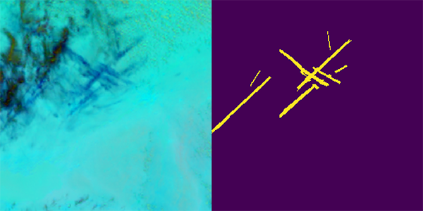
Dataset
Size of the dataset is 450GB
Notes:
The motivation behind this project is Imagine you have seen robots in various places, like factories, hospitals, or maybe even your own home. These robots are doing more than just staying in one place; they are moving around and interacting with people and objects.
Tools,parts delivery,medicine=customer,tool to doctor etc.
To make robots more useful and make sure they work smoothly in different situations, it's really important to teach them how to hand over objects in a flexible and easy way, just like how we humans do it naturally.

Slide 14
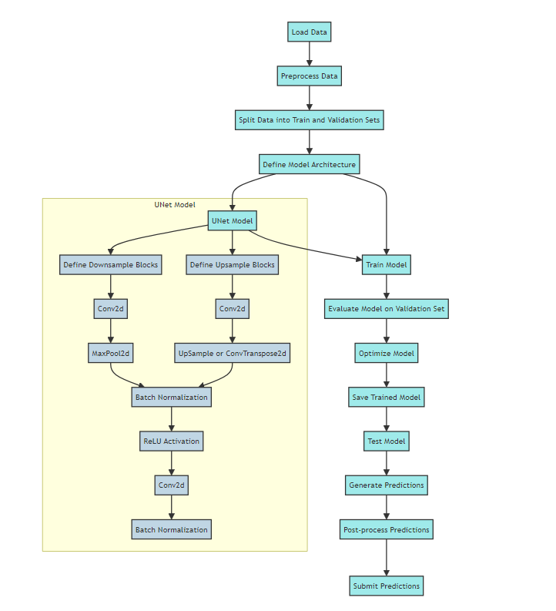
Approach
Notes:
The motivation behind this project is Imagine you have seen robots in various places, like factories, hospitals, or maybe even your own home. These robots are doing more than just staying in one place; they are moving around and interacting with people and objects.
Tools,parts delivery,medicine=customer,tool to doctor etc.
To make robots more useful and make sure they work smoothly in different situations, it's really important to teach them how to hand over objects in a flexible and easy way, just like how we humans do it naturally.

Slide 15
Approach
Our approach involves utilizing a U-Net architecture, a popular deep learning model for semantic segmentation tasks, to detect and segment contrails in satellite images.
This approach is well-suited for tasks where precise localization of objects within images is required, making it ideal for contrail detection.
U-Net follows an encoder-decoder architecture, where the encoder extracts hierarchical features from the input image while the decoder reconstructs the spatial information to produce segmentation masks.
This architecture is effective for capturing both local and global context, which is important for accurately detecting and segmenting contrails with varying sizes and shapes.
Notes:
The motivation behind this project is Imagine you have seen robots in various places, like factories, hospitals, or maybe even your own home. These robots are doing more than just staying in one place; they are moving around and interacting with people and objects.
Tools,parts delivery,medicine=customer,tool to doctor etc.
To make robots more useful and make sure they work smoothly in different situations, it's really important to teach them how to hand over objects in a flexible and easy way, just like how we humans do it naturally.

Slide 16
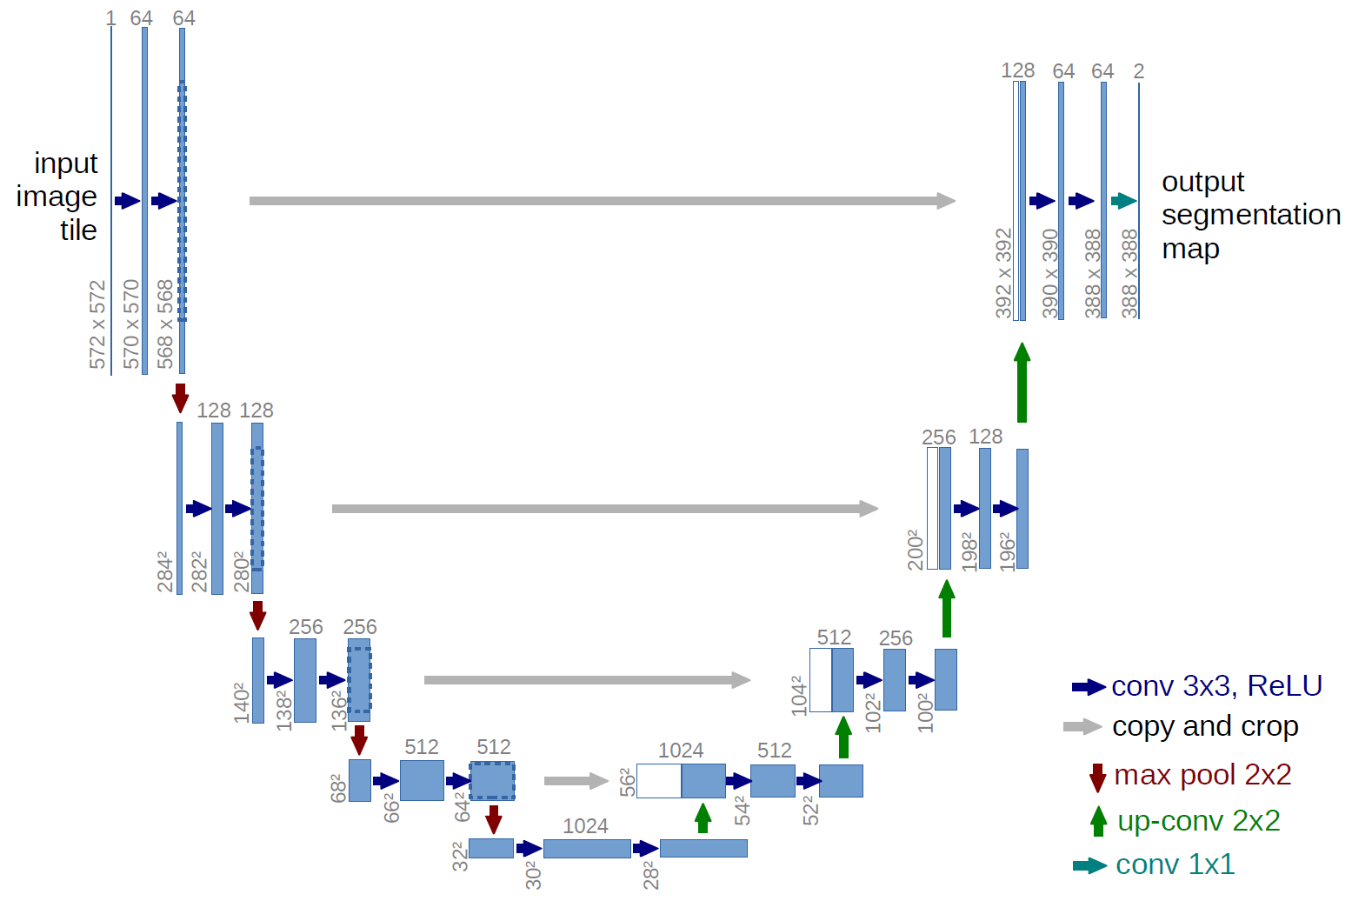
U-Net
U-Net

Slide 17
Approach
Down sampling (Encoder):
Reduces the spatial dimensions of the input feature maps while increasing the number of channels.
Achieved through operations like max-pooling or stride convolutions.
Helps in extracting high-level features by aggregating information from larger spatial regions.
Up sampling (Decoder):
Increases the spatial dimensions of the feature maps while reducing the number of channels.
Accomplished through techniques like transposed convolutions or up sampling followed by convolution.
Aims to recover spatial details lost during down sampling and refine the segmentation boundaries.
Notes:
The motivation behind this project is Imagine you have seen robots in various places, like factories, hospitals, or maybe even your own home. These robots are doing more than just staying in one place; they are moving around and interacting with people and objects.
Tools,parts delivery,medicine=customer,tool to doctor etc.
To make robots more useful and make sure they work smoothly in different situations, it's really important to teach them how to hand over objects in a flexible and easy way, just like how we humans do it naturally.

Slide 18
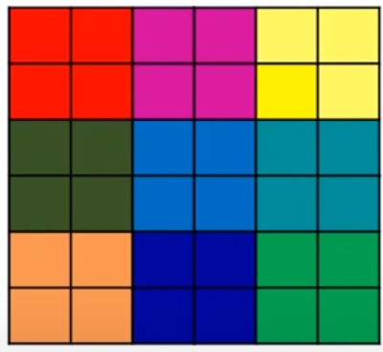
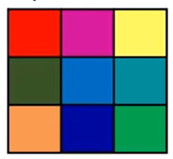
Approach
Up sampling:
Notes:
The motivation behind this project is Imagine you have seen robots in various places, like factories, hospitals, or maybe even your own home. These robots are doing more than just staying in one place; they are moving around and interacting with people and objects.
Tools,parts delivery,medicine=customer,tool to doctor etc.
To make robots more useful and make sure they work smoothly in different situations, it's really important to teach them how to hand over objects in a flexible and easy way, just like how we humans do it naturally.

Slide 19
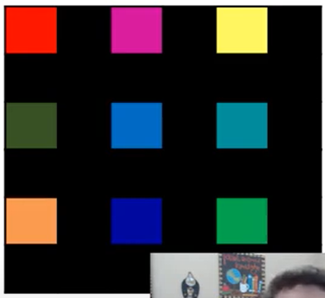

Approach
Conv transpose:
Notes:
The motivation behind this project is Imagine you have seen robots in various places, like factories, hospitals, or maybe even your own home. These robots are doing more than just staying in one place; they are moving around and interacting with people and objects.
Tools,parts delivery,medicine=customer,tool to doctor etc.
To make robots more useful and make sure they work smoothly in different situations, it's really important to teach them how to hand over objects in a flexible and easy way, just like how we humans do it naturally.

Slide 20
Approach
Concatenation:
Skip connections are established by concatenating feature maps from the down sampling path to the corresponding up sampling path.
Enables the model to preserve spatial information and capture details at multiple scales.
Output Layer:
Final layer responsible for producing the segmentation mask.
Typically consists of a 1x1 convolutional layer to map the features to the desired number of output channels.
Activation function may vary based on the task; for binary segmentation, a sigmoid activation is commonly used.
Notes:
The motivation behind this project is Imagine you have seen robots in various places, like factories, hospitals, or maybe even your own home. These robots are doing more than just staying in one place; they are moving around and interacting with people and objects.
Tools,parts delivery,medicine=customer,tool to doctor etc.
To make robots more useful and make sure they work smoothly in different situations, it's really important to teach them how to hand over objects in a flexible and easy way, just like how we humans do it naturally.

Slide 21
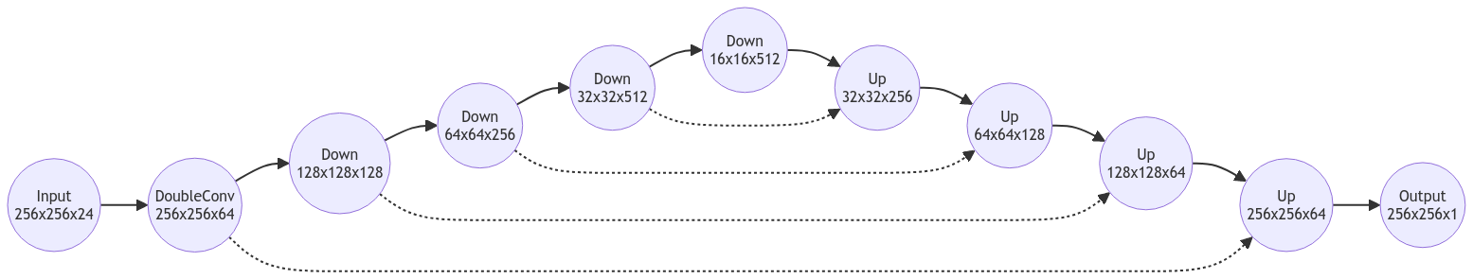
U-Net

Slide 22
Architecture
Layer | Input Size | Output Size | Input Channels | Output Channels
Input | 256x256x24 | - | 24 | -
inc | 256x256 | 256x256 | 24 | 64
down1 | 256x256 | 128x128 | 64 | 128
down2 | 128x128 | 64x64 | 128 | 256
down3 | 64x64 | 32x32 | 256 | 512
down4 | 32x32 | 16x16 | 512 | 512
up1 | 16x16 | 32x32 | 512 | 256
up2 | 32x32 | 64x64 | 256 | 128
up3 | 64x64 | 128x128 | 128 | 64
up4 | 128x128 | 256x256 | 64 | 64
Output | 256x256 | 256x256 | 64 | 1

Slide 23
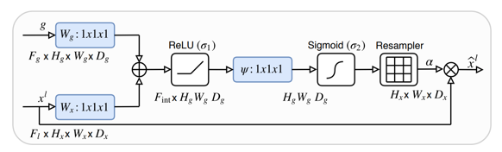
Variants
Attention Unet:
Notes:
The motivation behind this project is Imagine you have seen robots in various places, like factories, hospitals, or maybe even your own home. These robots are doing more than just staying in one place; they are moving around and interacting with people and objects.
Tools,parts delivery,medicine=customer,tool to doctor etc.
To make robots more useful and make sure they work smoothly in different situations, it's really important to teach them how to hand over objects in a flexible and easy way, just like how we humans do it naturally.

Slide 24
Variants
Residual Unet:
Attention + Residual Unet:
Notes:
The motivation behind this project is Imagine you have seen robots in various places, like factories, hospitals, or maybe even your own home. These robots are doing more than just staying in one place; they are moving around and interacting with people and objects.
Tools,parts delivery,medicine=customer,tool to doctor etc.
To make robots more useful and make sure they work smoothly in different situations, it's really important to teach them how to hand over objects in a flexible and easy way, just like how we humans do it naturally.

Slide 25
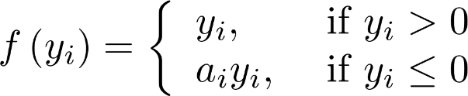
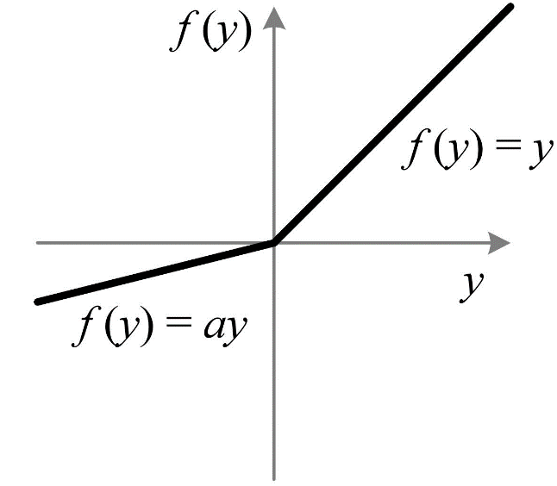
Approach
PReLU activation function
Unlike ReLU, which can lead to "dead neurons" if many weights lead to negative inputs, ELU has a continuous gradient for negative values.
The learnable parameter a provides flexibility to the activation function, enabling it to adapt to specific patterns in the data.
Notes:
The motivation behind this project is Imagine you have seen robots in various places, like factories, hospitals, or maybe even your own home. These robots are doing more than just staying in one place; they are moving around and interacting with people and objects.
Tools,parts delivery,medicine=customer,tool to doctor etc.
To make robots more useful and make sure they work smoothly in different situations, it's really important to teach them how to hand over objects in a flexible and easy way, just like how we humans do it naturally.

Slide 26
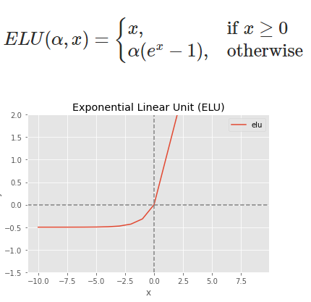
Approach
ELU activation function
Unlike ReLU, which can lead to "dead neurons" if many weights lead to negative inputs, ELU has a continuous gradient for negative values.
ELU has a smooth derivative, even for negative values, which can help maintain a more consistent gradient flow during backpropagation.
ELU can help models generalize better due to its smooth nature
Notes:
The motivation behind this project is Imagine you have seen robots in various places, like factories, hospitals, or maybe even your own home. These robots are doing more than just staying in one place; they are moving around and interacting with people and objects.
Tools,parts delivery,medicine=customer,tool to doctor etc.
To make robots more useful and make sure they work smoothly in different situations, it's really important to teach them how to hand over objects in a flexible and easy way, just like how we humans do it naturally.

Slide 27
Parameters
Epochs – 10
Loss function – BCE (CONTRAIL / NO CONTRAIL)
Optimizer – Adam
Lr scheduler – Exponential decay
Notes:
The motivation behind this project is Imagine you have seen robots in various places, like factories, hospitals, or maybe even your own home. These robots are doing more than just staying in one place; they are moving around and interacting with people and objects.
Tools,parts delivery,medicine=customer,tool to doctor etc.
To make robots more useful and make sure they work smoothly in different situations, it's really important to teach them how to hand over objects in a flexible and easy way, just like how we humans do it naturally.

Slide 28
Evaluation Metrics
The Dice coefficient can be used to compare the pixel-wise agreement between a predicted segmentation and its corresponding ground truth.
Dice = 2×∣P∩G∣​ / ∣P∣+∣G∣
P represents the set of pixels predicted as contrails by the model.
G represents the set of pixels annotated as contrails in the ground truth.
Accuracy
Precision
Recall
F1

Slide 29
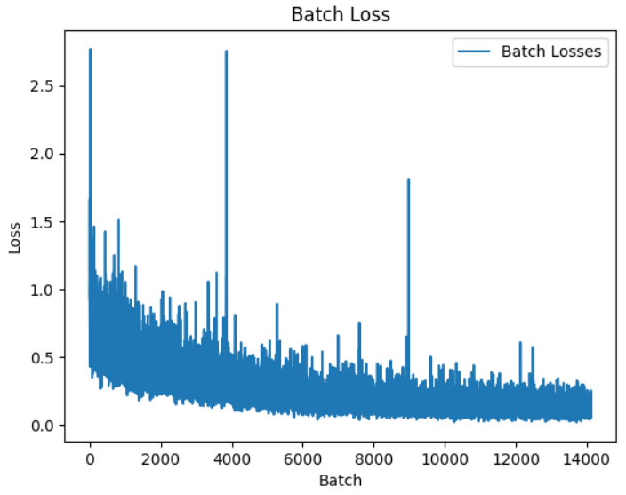
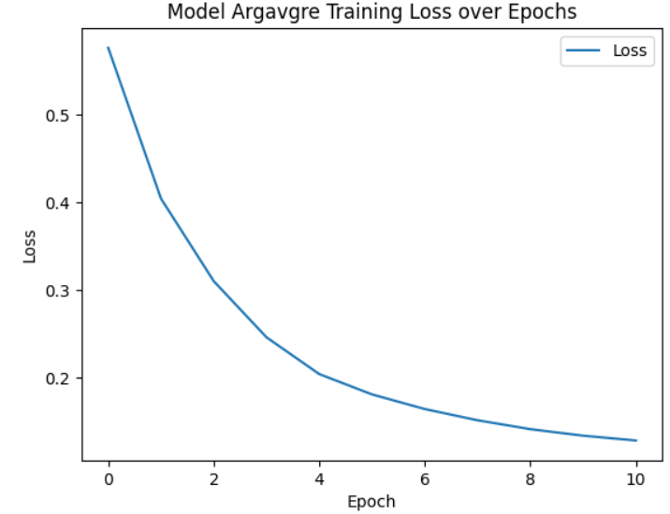
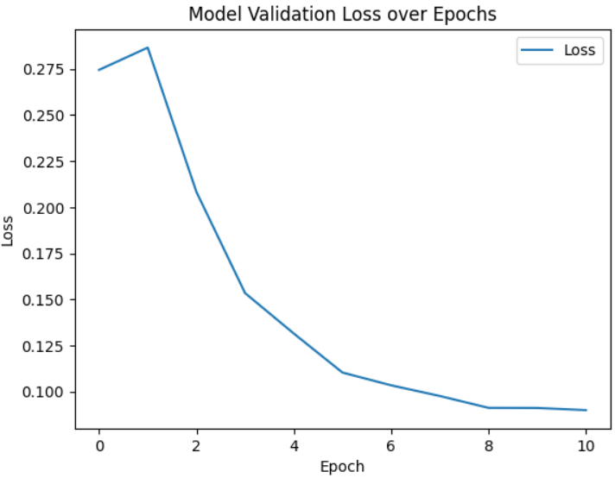
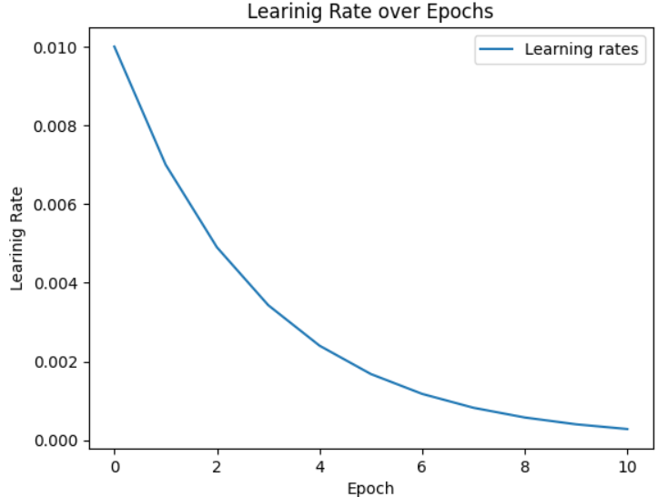
Results

Slide 30
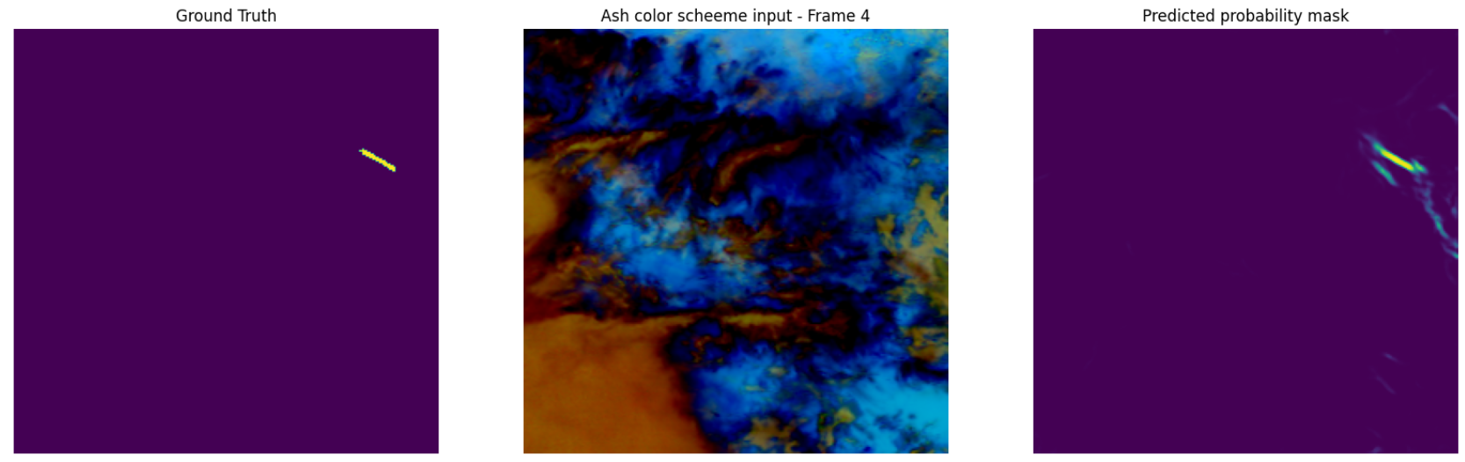
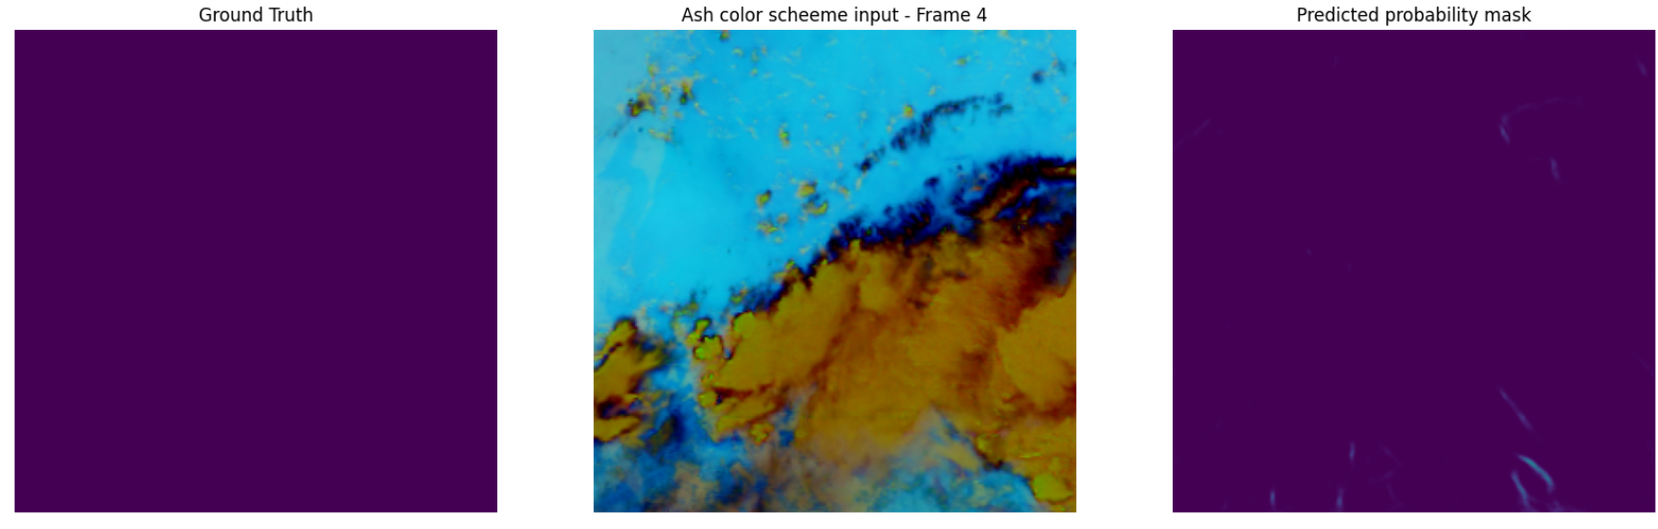
Results

Slide 31
Results
Model | Avg Accuracy | Avg Precision | Avg Recall | Avg F1 | Dice score
UNet (without thresholding) | 98.73 | 10.52 | 87.87 | 18.44
UNet (with thresholding) |  |  |  |  | 50.2
Residual UNet (without thresholding) | 98.97 | 12.48 | 82.70 | 21.32
Residual UNet (with thresholding 0.97) | 99.81 | 44.31 | 48.20 | 45.00 | 50.7
Attention UNet (without thresholding) | 99.1 | 11.21 | 61.22 | 18.11
Attention UNet (with thresholding 0.96) | 99.83 | 37.44 | 34.33 | 33.03 | 51.2
Attention Residual UNet (without thresholding) | 98.82 | 10.80 | 84.26 | 18.78
Attention Residual UNet (with thresholding 0.97) | 99.82 | 44.83 | 48.41 | 45.05 | 52.6

Slide 32
Results
Attention Residual UNet with ELU activation function ( without thresholding) | 98.95 | 12.42 | 87.00 | 21.40
Attention Residual UNet with ELU activation function ( with thresholding 0.97) | 99.83 | 49.58 | 50.84 | 48.52 | 53.8
Attention Residual UNet with PRELU activation function ( without thresholding) | 99.01 | 15.4 | 80.49 | 25.33
Attention Residual UNet with PRELU activation function ( with thresholding 0.98) | 99.84 | 53.33 | 46.63 | 48.38 | 53.18

Slide 33
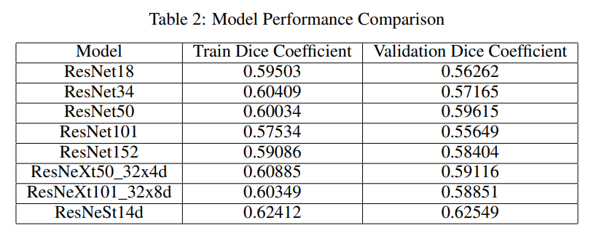
Results

Slide 34
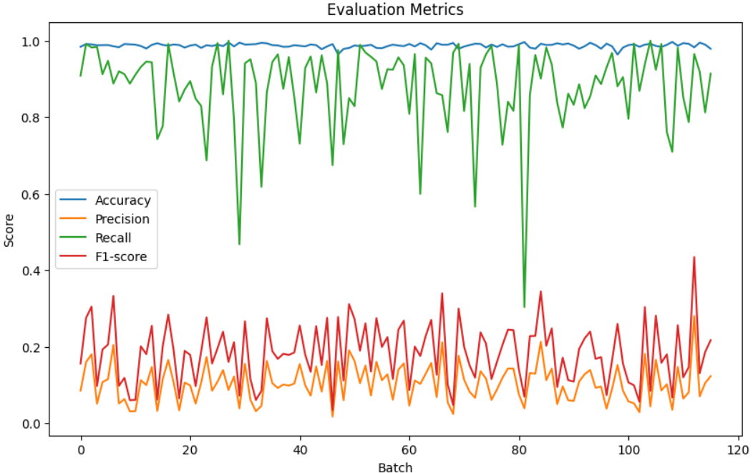

Results

Slide 35
Timeline
Literature Survey
Abstract Submission
23/02/2024
10/03/2024
24/04/2024
Document Submission
14/04/2024
Testing
07/04/2024
Implementation
20/03/2024
Design [Neural Networks]

Slide 36
Conclusion
In conclusion, the task of detecting contrails from satellite images holds significant importance in understanding their role in global warming and climate dynamics. By utilizing deep learning methodologies like the U-Net architecture and assessing performance using metrics such as the Dice coefficient, we aim to develop precise model for contrail detection. Through strategies to address class imbalance and optimize model performance, we strive to improve the accuracy and reliability of contrail detection methods. These advancements have the potential to inform strategies and policies aimed at mitigating the environmental impact of aviation activities.
Notes:
"Image to Audio for Enhanced Accessibility," represents a substantial advancement in addressing accessibility challenges for visually impaired individuals. Compared to previous projects, our approach excels in accuracy, quality, and user satisfaction, promising significantly better results. We combine cutting-edge deep learning techniques, extensive dataset utilization, and user feedback to provide a more efficient and user-centric solution.
Our dedication to continuous improvement ensures we remain at the forefront of accessibility technology, offering visually impaired individuals a level of independence and inclusivity previously unattainable.
In essence, our project sets new standards for digital accessibility, providing superior results and enhancing the lives of the visually impaired community.

Slide 37
References
1. Ng, Joe Yue-Hei, et al. "OpenContrails: Benchmarking Contrail Detection on GOES-16
ABI." arXiv preprint arXiv:2304.02122 (2023).
2. Chevallier, Rémi, et al. "Linear contrails detection, tracking and matching with aircraft using
geostationary satellite and air traffic data." Aerospace 10.7 (2023): 578.
3. Siddiqui, Nasir. "Atmospheric Contrail Detection with a Deep Learning Algorithm." Scholarly
Horizons: University of Minnesota, Morris Undergraduate Journal 7.1 (2020): 5.
4. Nipu, Nafiul, et al. "Visual Analysis and Detection of Contrails in Aircraft Engine
Simulations." IEEE Transactions on Visualization and Computer Graphics 29.1 (2022): 798-
808.
5. Hoffman, Jay P., et al. "The Application of a Convolutional Neural Network for the Detection of Contrails in Satellite Imagery." Remote Sensing 15.11 (2023): 2854.

Slide 38
THANK YOU

